Slide 1
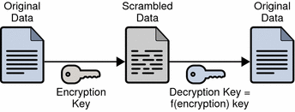
Symmetric Key Ciphers and AES

Slide 2
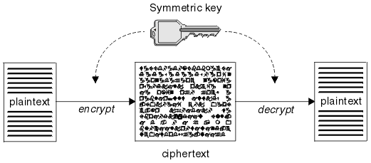
Symmetric Key Ciphers
Symmetric key ciphers
Use the same key (or password) to encrypt and decrypt data
Popular symmetric algorithms
AES, Twofish, IDEA, Serpent, RC5, RC6
Broken algorithms (don't use them!)
DES, 3DES, RC2, RC4
AES
IDEA
Twofish
RC6
RC5

Slide 3
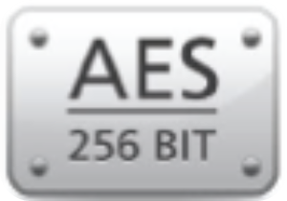
The "AES" Cipher
AES – Advanced Encryption Standard (Rijndael)
Symmetric key block cipher algorithm
Key lengths: 128, 160, 192, 224 and 256 bits
No significant practical attacks are known for AES
Modern CPU hardware implements AES instructions
This speeds-up AES and secure Internet communication
AES is used by most Internet Web sites for https:// content

Slide 4
Symmetric Key Ciphers
Stream ciphers
Work on sequences of data (encrypts / decrypts byte by byte)
Block ciphers
Split data on blocks (e.g. 128 bits with padding), then encrypt each block separately, change the key, encrypt the next block, …
Block ciphers can be transformed to stream ciphers
Using block mode of operation (e.g. ECB, CBC, CTR, …)
https://en.wikipedia.org/wiki/Block_cipher_mode_of_operation

Slide 5
AES Cipher Settings
AES is a "block cipher" – encrypts block by block (e.g. 128 bits)
It has several modes of operation (CBC, ECB, CTR, …)
Some modes of operation require initial vector (IV)
Non-secret random salt → used to get different result each time
Recommended modes: CBC (Cipher Block Chaining), CTR (Counter)
It may use a padding algorithm (typically PKCS7) to split the input data into blocks of fixed block-size (e.g. 128 bits)
It may use password to key derivation function, e.g. Scrypt(passwd)
It may use MAC to check the password validity, e.g. HMAC(text, key)

Slide 6
Example: AES Encrypt / Decrypt in Python
import pyaes, pbkdf2, binascii, os, secrets
plaintext = "Sample text for encryption"
password = "s0m3p@$$w0rd"
key = pbkdf2.PBKDF2(password, 'some salt').read(16)
print('AES encryption key:', binascii.hexlify(key))
iv = secrets.randbelow(2 << 128)
aes = pyaes.AESModeOfOperationCTR(key, pyaes.Counter(iv))
ciphertext = aes.encrypt(plaintext)
print('encrypted:', binascii.hexlify(ciphertext))
aes = pyaes.AESModeOfOperationCTR(key, pyaes.Counter(iv))
decrypted = aes.decrypt(ciphertext)
print('decrypted:', decrypted)
pip install pyaes
pip install pbkdf2

Slide 7

Symmetric Key Ciphers and AES
Try the Code!

